Slide 1
Gout & Hyperuricemia
Definition
↑ uric acid level (> 7 mg/dL)
Uric acid
product of purine metabolism; excreted renally
Uric acid has no physiological function

Slide 2
Gout & Hyperuricemia
Causes:
Overproducers
De novo synthesis, excessive dietary purine intake, excessive nucleoprotein turnover
- Nutritional
- Hematologic
- Drugs
- Miscellaneous
Tumor lysis syndrome
- Chemotherapy destroys tumor cells … massive release of cellular DNA
Underexcretors
Defect in renal excretion
Uric acid is filtered→reabsorbed→secreted distal to the proximal tubular’s reabsorption site→reabsorbed again (75%)
- Drugs
- Renal
- Metabolic / endocrine
- Miscellaneous

Slide 3
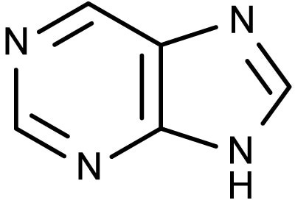
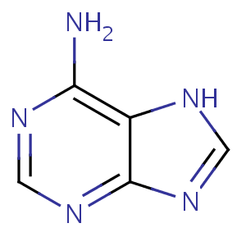
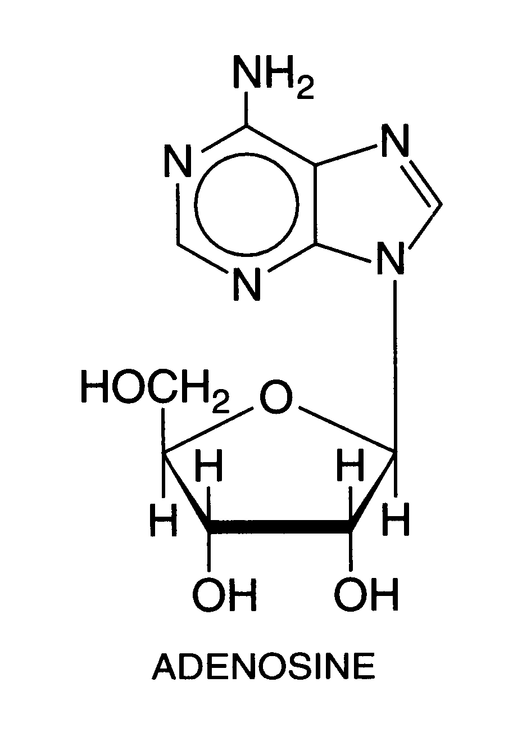
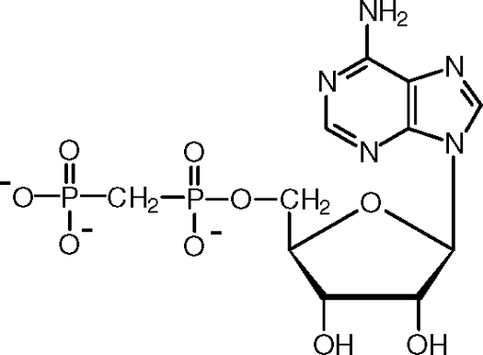
Purine
Adenine
(base)
(nucleoside)
Adenosine Phosphate
(nucleotide)

Slide 4
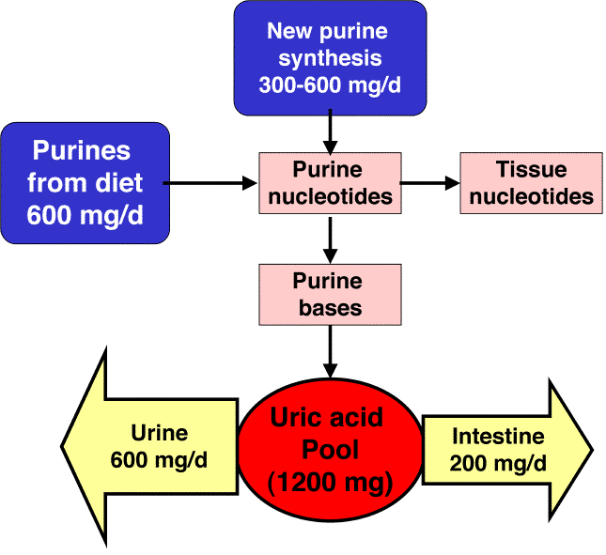
~ 50%
~ 17%

Slide 5
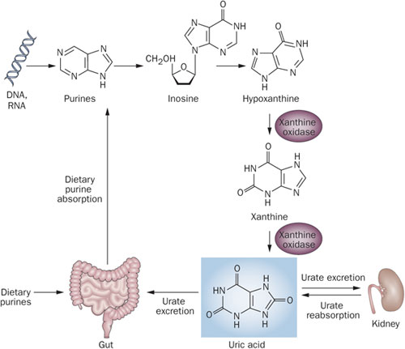
Metabolism of Purines
Allopurinol
Allantoin
(soluble inactive)
Uricase

Slide 6
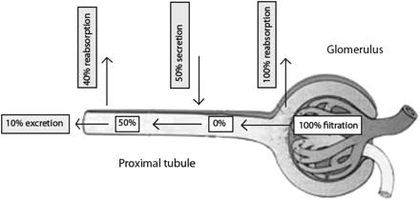
Renal Excretion of Uric Acid
~ 25% excretion

Slide 7
Drug-Induced Hyperuricemia
Cyclosporine | Levodopa
DDI | Methyldopa
Diuretics | Niacin
Ethambutol | Pancreatin / Pancrealipase
Glucocorticoids | Pyrazinamide
G-MCSF | Salicylates (low dose)
Ketoconazole | Theophylline
Complications:
- Gout
- Nephrolithiasis
- Nephropathy
- Tophaceous gout

Slide 8
GOUT
Disorder of uric acid metabolism
Most common inflammatory joint disease (deposits of monosodium urate crystals) in men > 40 y.o.
Men vs. women – more common in men than women
Uncommon < 30 years old; usually occurs in middle age
Four Clinical Phases of Gout
1. Asymptomatic hyperuricemia
2. Acute gout
3. Intercritical gout
Time between gout attacks is known as the intercritical period; if not treated properly, the time between attacks is shortened
4. Chronic tophaceous gout
Gout can either manifest as acute arthritis or chronic arthropathy, which is also called tophaceous gout

Slide 9
Precipitating Factors
Trauma
ETOH
Hypouricemic therapy
If started initially during an acute gouty attack in naiive patients
Does not apply to patients already on this therapy and who may experience a gout attack while on uric acid lowering therapy
↑ physical activity
Overindulgence in rich foods
Drugs
Diagnosis
Gold standard
Urate crystal
Diagnosed with polarized microscopy “needle-like crystals with negative birefringence”
Synovial fluid--decrease viscosity; increase neutrophils

Slide 10
Whom to Treat for Hyperuricemia
Consider drug therapy if:
Patient has 3-4 definite attacks of gout in a year
Patient has tophi
Patient has nephrolithiasis
Patient has nephropathy
NOT Asymptomatic hyperuricemic
Up to 2/3 of patients with hyperuricemia never develop symptoms or complications
Medications:
Allopurinol - Rasburicase - NSAIDs
Probenecid - Pegloticase - Corticosteroids
Febuxostat - Colchicine
Never start hypouricemic Tx during an acute attack
Doesn't help and may induce a recurrent attack by mobilizing uric acid from the tissues. However, if pt is on hypouricemic tx, don't d/c during acute attacks.

Slide 11
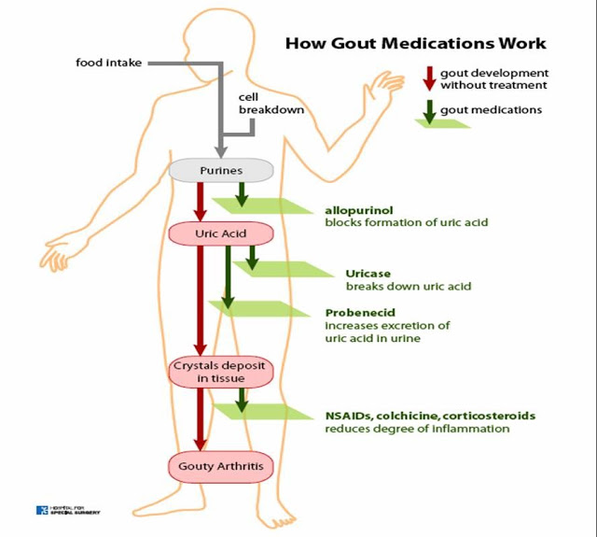
http://health-fts.blogspot.com/2012/03/gout.html

Slide 12
Allopurinol
Current mainstay of Tx
MOA
Effective in both under- excretors & overproducers of uric acid
Dosing tips:
< 100 mg daily … 50 mg in pts with CKD
Gradual upward titration based on uric acid levels (2-5 wks)
Most will not need more than 300 mg/day … however, some may need > 300 mg/day even with CKD
Screen high risk pts for HLA-B*5801 (Koreans with CKD, Han Chinese, Thai descent)
Monitoring:
Uric acid … only uric acid for Probenecid
Skin Rx
Renal disease (SCr)

Slide 13
Drug-Drug Interactions with Allopurinol
Allopurinol
6-MMP
(inactive)
Xanthine oxidase
Azathioprine
6-mercaptopurine
6-thiouracil
(inactive)
Bone marrow suppression
↓ Azathioprine/ 6-MP dose by 50% when allopurinol is added

Slide 14
Drug-Drug Interactions with Allopurinol
ACE-Inhibitors
may predispose patients to severe allopurinol-hypersensitivity reactions
Warfarin
enhance anticoagulant effects
Reaction is minor
Cyclophosphamide
↑ cyclophosphamide-bone marrow suppression (mechanism unknown)
Aluminum hydroxide
decrease absorption; take allopurinol 3 hours before or 6 hours after
Ampicillin
drug rash often greater with allopurinol co-administration
Theophylline
decrease theophylline clearance; ↑ concentration

Slide 15
Drug-Drug Interactions with Probenecid
Methotrexate
Increase concentration of MTX that could possibly enhance therapeutic and toxic effects
Penicillins/beta lactams
Increase PCN concentration (drug is used for this effect)
Salicylates
reduce uricosuric effects of probenecid

Slide 16
Febuxostat
Non-purine selective inhibitor of xanthine oxidase
Oral therapy
Dose: initial 40 mg daily; may increase to 80 mg daily
No renal dosing; primarily hepatic; does require LFT monitoring (baseline, then 2 and 4 months after initiation and then periodically)
Approved in 2009; Uloric
Again, blocks the conversion of hypoxanthine to xanthine to uric acid
Drug interactions like allopurinol regarding mercaptopurine and azathioprine; theophylline
Adverse effects:
LFT abnormalities (5 to 7%)
rash (1-2%)
Clinical trials also showed and increased risk of MI and CVA when compared to allopurinol, but cannot link a causal relationship/ mechanism of adverse effect

Slide 17
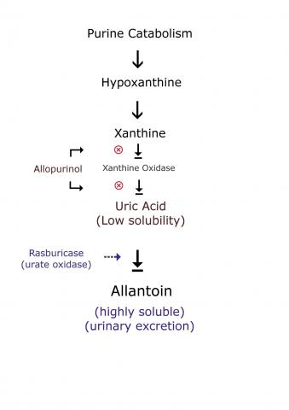
Rasburicase
Indication: chemotherapy induced hyperuricemia
Biosynthetic form of urate oxidase which is an enzyme that oxidizes uric acid to an inactive and soluble metabolite called allantoin
Generally for the pediatric population in childhood leukemias
Dose 0.15-0.2 mg/kg IV push for 5-7 days
Some studies looked at one time dosing
Generally rasburicase has a rapid and marked effect on uric acid level reduction
Hemolytic Anemia
Contraindicated in patients with G6PD deficiency
Methemoglobinemia
Anaphylaxis
Common AE’s: N,V,D, fever
Glucose-6-phosphate dehydrogenase deficiency causes hemolysis
Methhemoglobin cannot bind oxygen

Slide 18
Pegloticase
Brand Krystexxa
Pegylated recombinant form or urate oxidase (uricase)
Again, converts uric acid to allantoin
Approved for the treatment of chronic gout refractory to conventional therapy
Dose: 8 mg IV every two weeks
Gout flare prophylaxis with NSAIDs and colchicine is recommended beginning one week prior to therapy and continuing for at least 6 months
ANAPHYLAXIS
Patients must be premedicated with antihistamines and corticosteroids
Infuse over > 120 minutes
Monitor for s/sx of anaphylaxis during infusion and for up to two hours after infusion
Delayed reactions have also been reported
The higher the uric acid level, the greater the risk of anaphylaxis
Contraindicated in patients with G6PD deficiency
Caution with use in patients with HF
Formation of antipegloticase antibodies - Repeat infusions will lead to anaphylaxis

Slide 19
Colchicine
Colchicine as branded Colcrys “officially approved by the FDA” but this dosing refers to all generic forms
Acute attack dosing: 1.2 mg po then 0.6 mg po one hour
In patients with severe renal or hepatic insufficiency any further courses should be avoided for two weeks
Adverse Effects
GI: cramping, nausea, diarrhea
Rare but dangerous to fatal:
Myelosuppression
Neuromyopathies
Drug Interactions (more so when colchicine is used chronically for prophylaxis)
Colchicine is a substrate of:
CYP 3A4 – interaction with strong CYP 3A4 inhibitor drugs
P-glycoprotein
Pharmacodynamic: Drugs that increase risk for myopathy
Not for pts with renal or hepatic impairment

Slide 20
NSAIDs
For Acute Gout Attack
Really are the drugs of choice unless there is relative contraindication for not using
Any NSAID can be used; indomethacin is NOT preferred
Naproxen: 750 mg po x 1; then 250 mg po q8h or just 500 mg po BID
Aspirin is avoided because of the paradoxical effects of salicylates on serum uric acid resulting at renal uric acid retention at doses < 2 to 3 gram/day

Slide 21
Corticosteroids
Another option for acute gout
Prednisone 30-60 mg po daily then taper over 7-10 days
Intra-articular: methylprednisolone
Small joint: 10-20 mg
Large joint: 20-60 mg
Investigational Tx
Target Interleukin-1 (IL-1)
Important mediator of inflammation in acute gout therefore a therapeutic target
Anakinra
Canakinumab

Slide 22
Prophylaxis
Generally after an acute flare
Colchicine 0.6-1.2 mg daily (generally at the 0.6 mg daily; watch renal function)
NSAIDs (i.e. naproxen 500 mg po BID)
Prophylaxis for both agents is needed for as long as 6-12 months for most patients (or even lifetime depending on # of attacks vs. risk of long term colchicine or NSAID therapy)

